Slide 1

Image DATA – Recognised HANDWRITTEN DIGITS
By:
P. SRI SAI SATHVIK
(AI-ELITE-7)-(BATCH-191)
G.MANASWANI
(AI-ELITE-7)-(BATCH-182)

Slide 2
TABLE OF CONTENTS
Problem Statement
Extracting Image Data
Image Data Extraction
Resizing the image and converting to DataFrame
EDA
Data Pre-processing
Model Building
Predicting the Accuracy
Challenges Faced
Conclusion

Slide 3
Problem Statement
Task - Build a image classification model to annotate each image into one of the 26 classes.

Slide 4

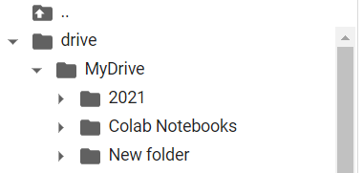
Extracting Our Image Data

Slide 5
Resizing the image AND CONVERTING TO DATAFRAME
Read the images using PIL python package.
Resize and convert PIL image object to numpy array.
Flatten numpy array and use it as numeric representation of image.
Append the flattened array to pandas dataframe and label it.

Slide 6
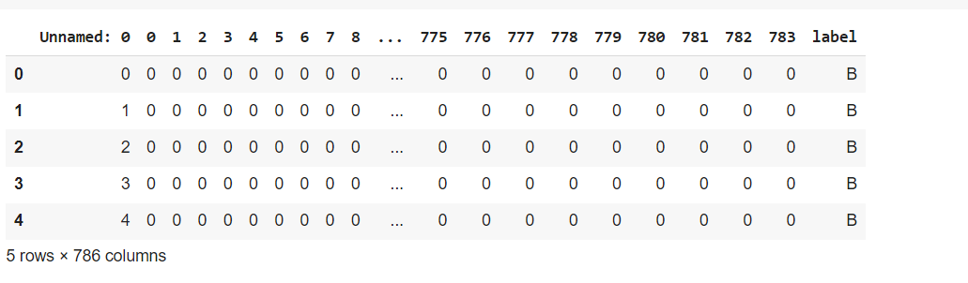
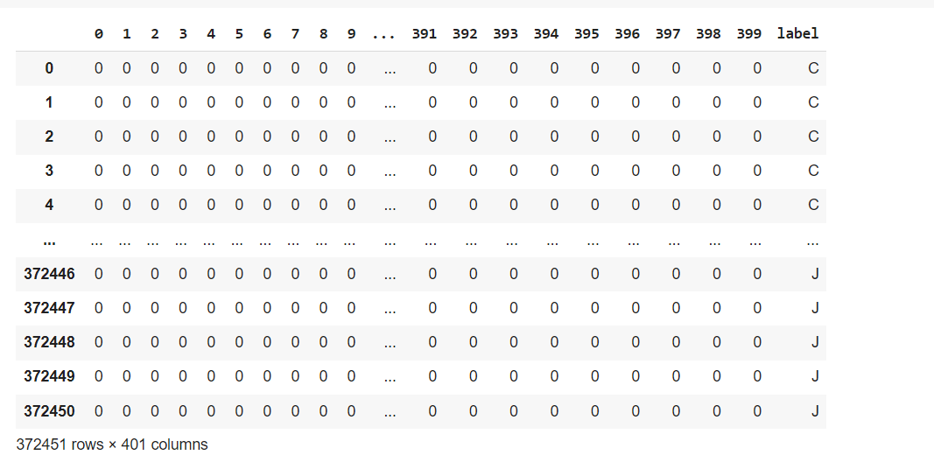
Resizing the image AND CONVERTING TO DATAFRAME continuation
BEFORE RESIZING THE IMAGE DATA
AFTER RESIZING THE IMAGE DATA
FIRST FLATTEN THE IMAGE BY USING NUMPY
AND THEN CONVERT IT INTO DATAFRAME
2. BEFORE RESIZING THE IMAGE IT IS HAVING IMAGE SIZE OF 28 * 28 and 786 columns
3. AFTER RESIZING NOW IMAGE DATA IS HAVING 20 * 20 and having 400 columns

Slide 7
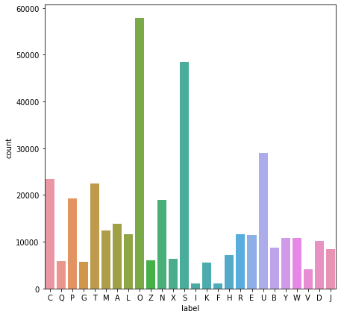
EDA
AFTER RESIZING THE IMAGE DATA THE COUNT PLOT IS AS BELOW:
HERE WE OBSERVE THAT O IS HAVING MORE DATA THAN OTHER DATA

Slide 8
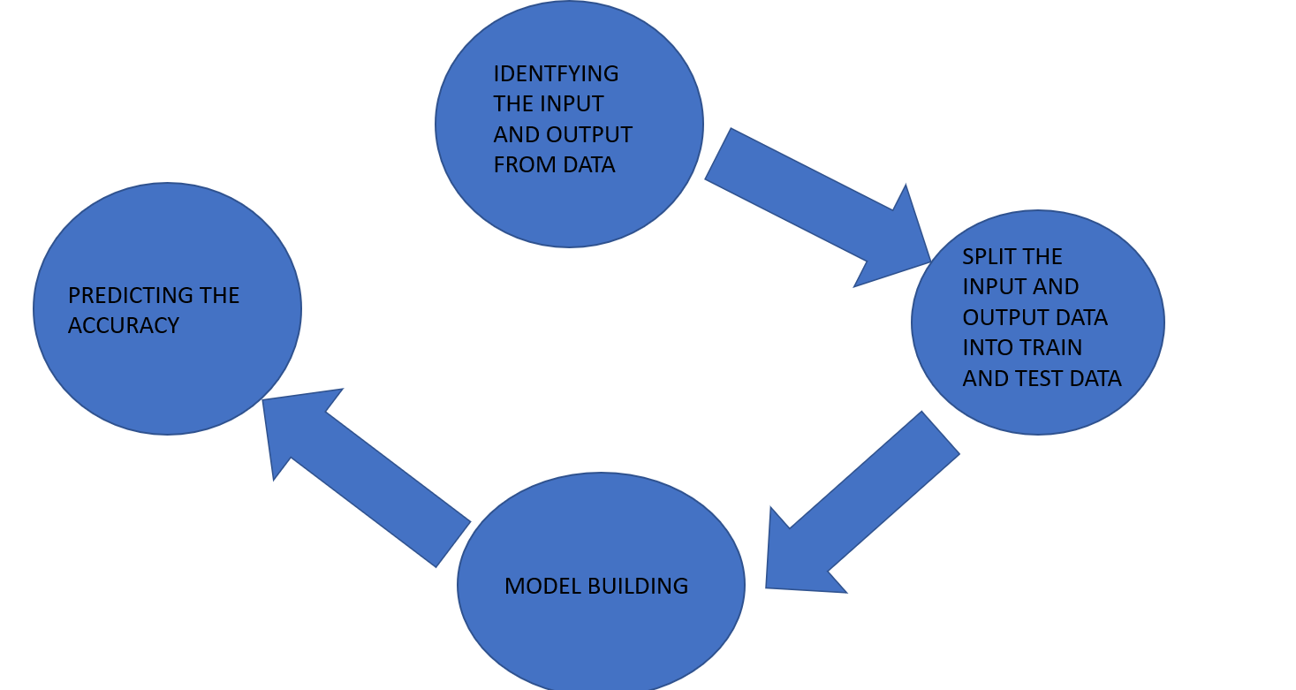
Data LIFECYCLE OF OUR PROJECT

Slide 9
MODEL BUILDING
AFTER TRAINING AND TESTING NOW WE ARE BUILDING AND TRAINING THE DATAFRAME AS FOLLOWS:
LOGISTIC REGRESSON took 2 mins
DECISION TREE took 2mins 30 secs
RANDOM FOREST took 3 mins
ADA BOOST took 4 mins
BAGGING took 11 mins

Slide 10
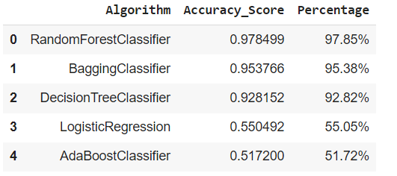
ACCURACY
THE ACCURACY OF DATASET MODELS IS AS FOLLOWS

Slide 11
CONCLUSION
FROM THE ABOVE OBSERVATION RANDOM FOREST IS THE BEST ALGORITHM AND IT IS HAVING 97.85%
SO, RANDOM FOREST ALGORITHM WILL BE SUITED FOR THIS DATASET

Slide 12
ANY QUERIES

Slide 13
THANK YOU

